Slide 1
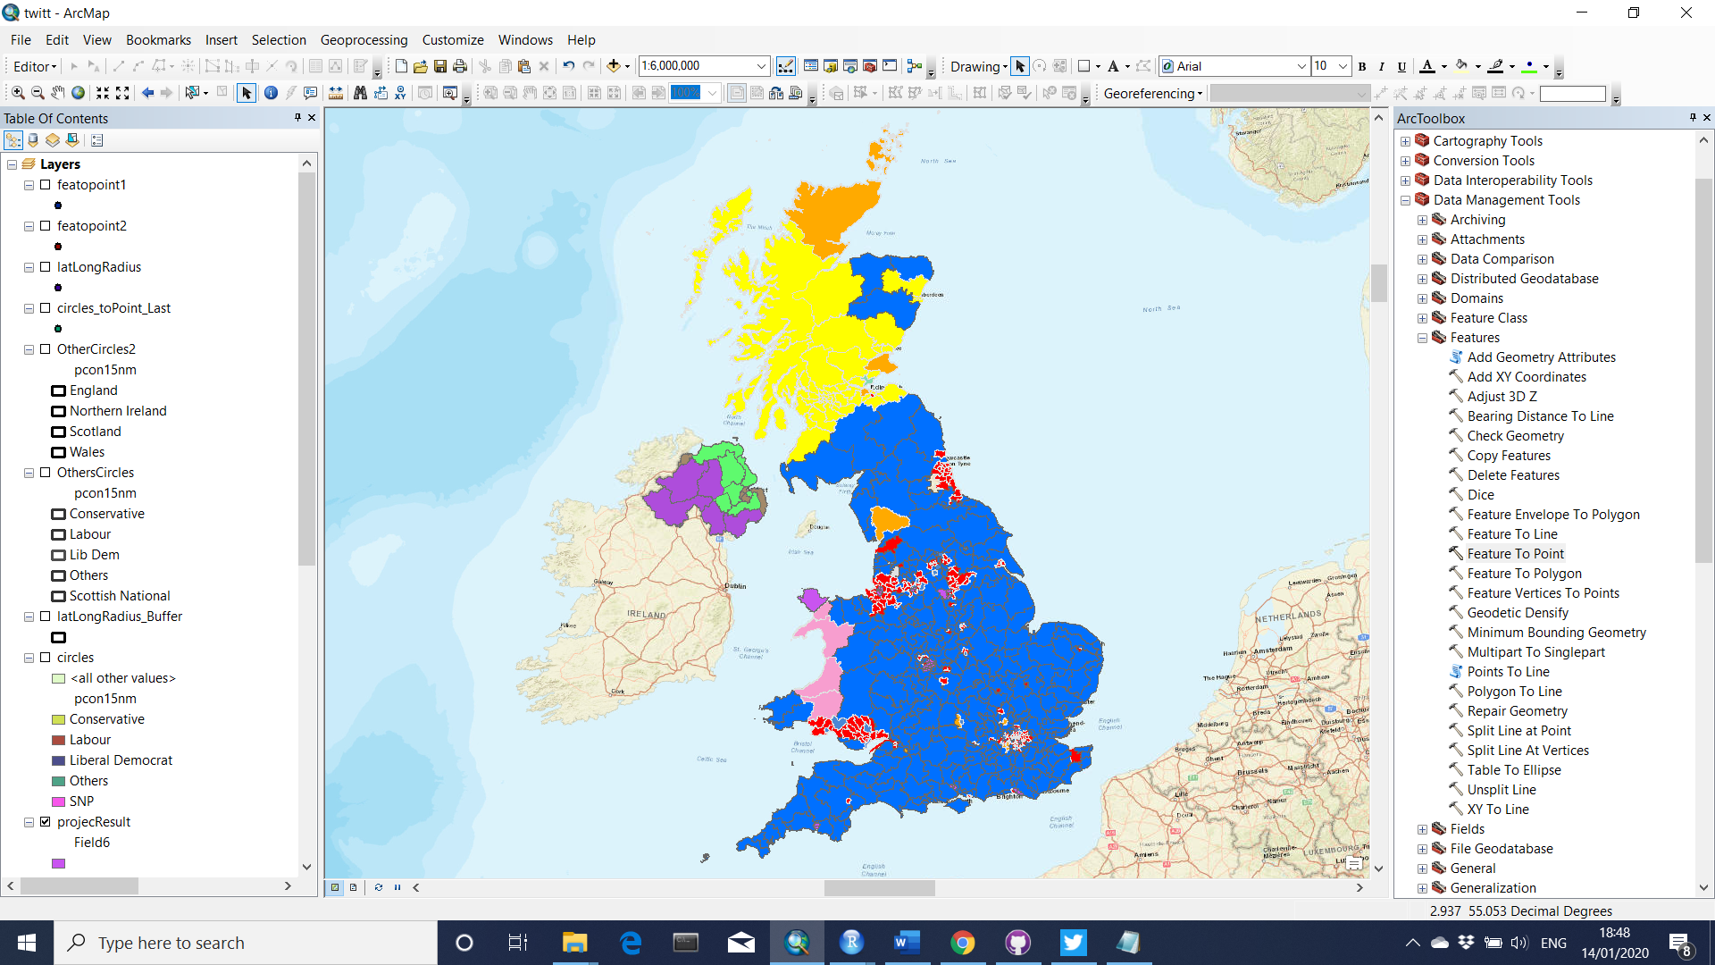
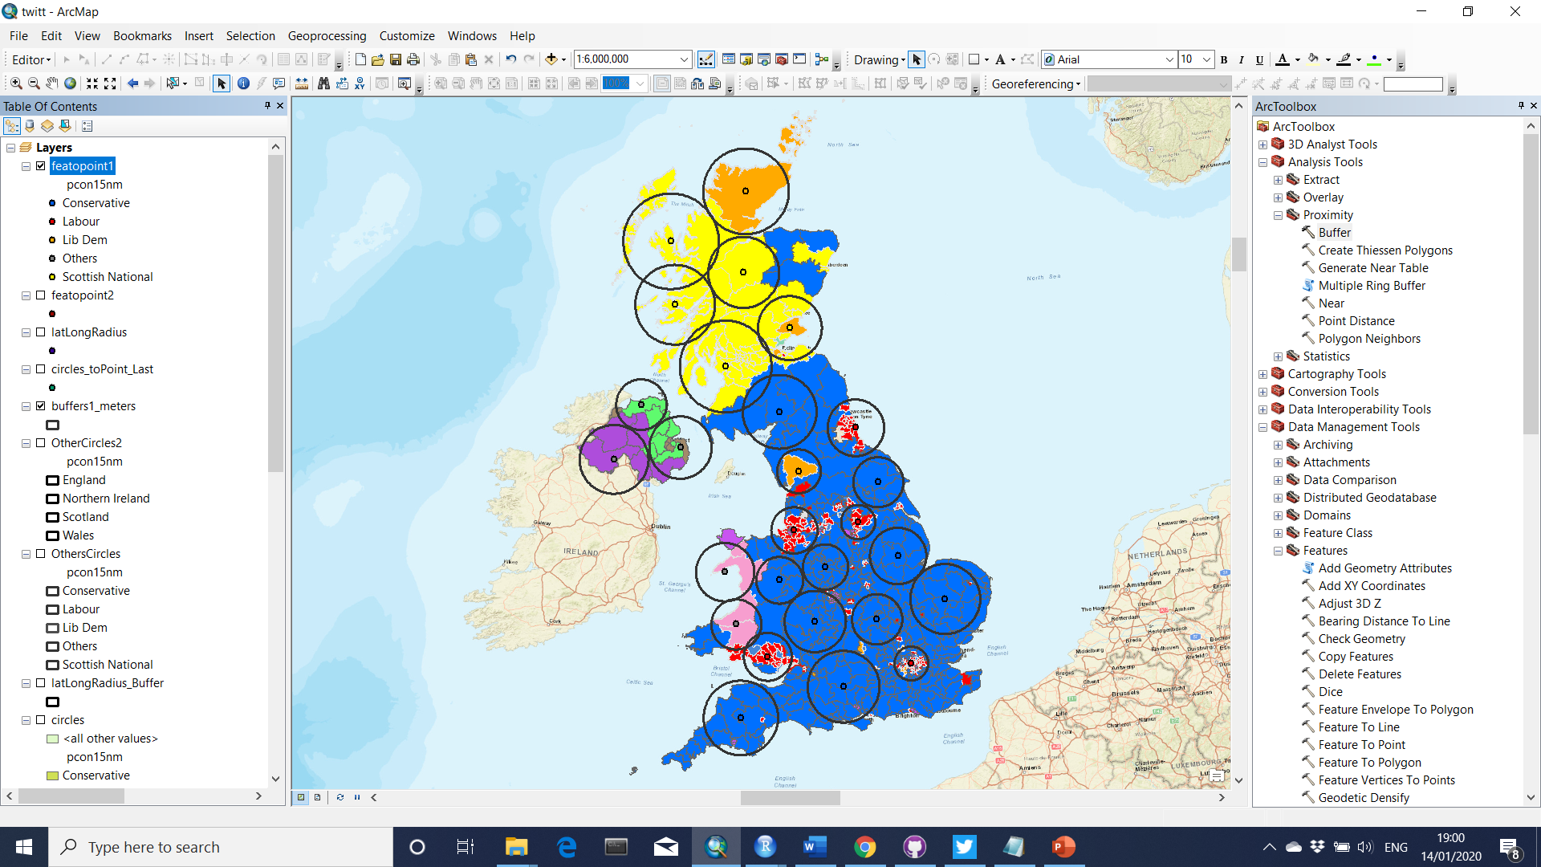
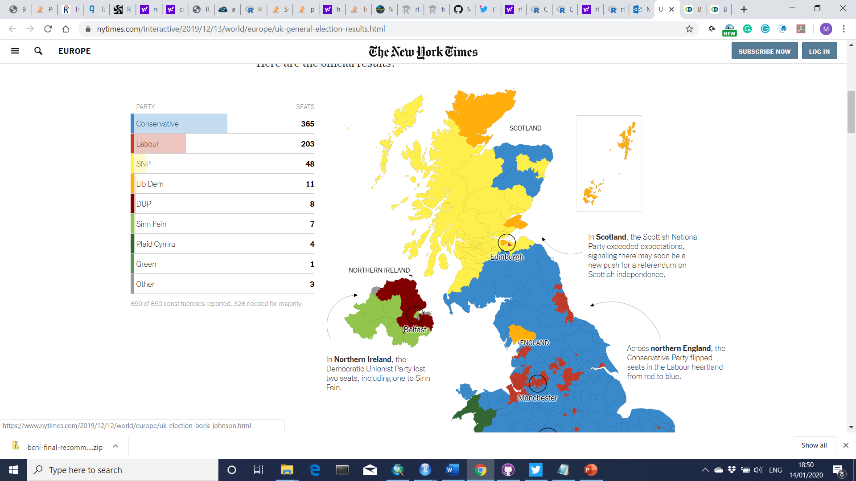
UK 2019 General Election Results
Data collection (by Voting Results)

Slide 2
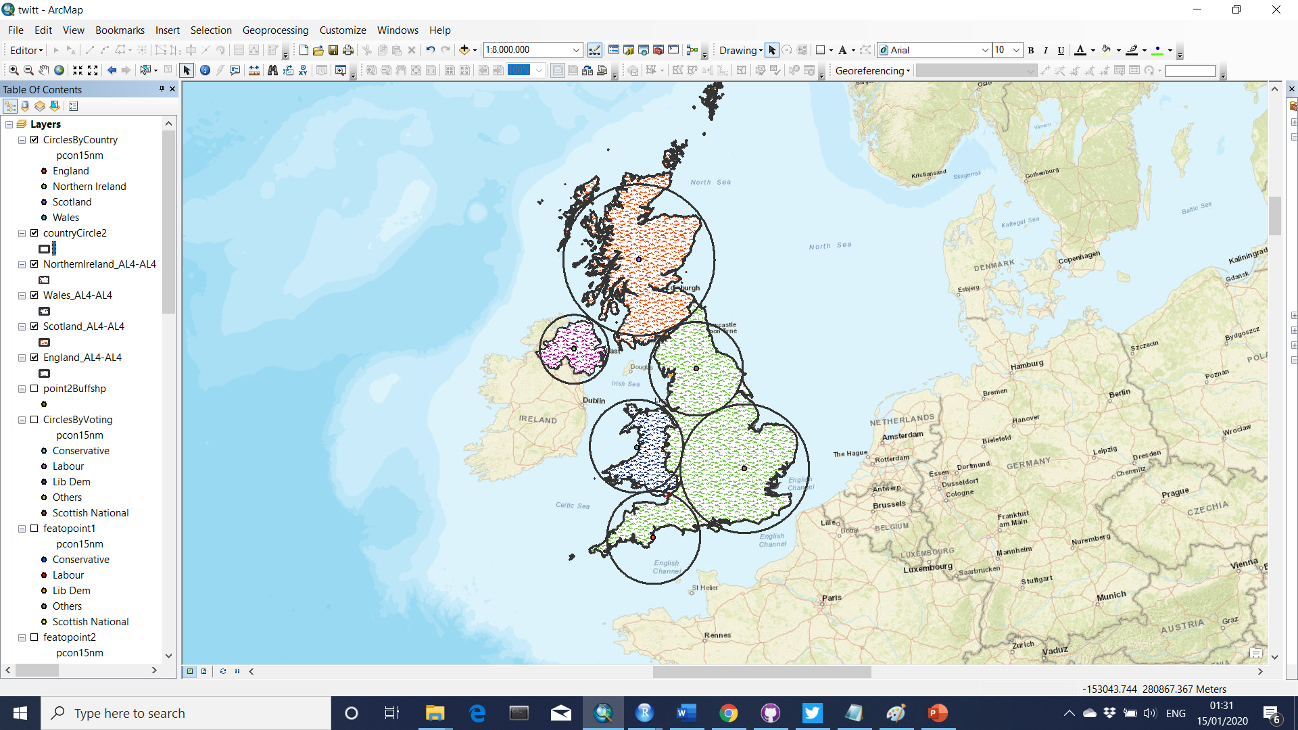
Data collection (by Country)
Data collection (by Voting Results)
England
Wales
North. Ire.
Scotland

Slide 3
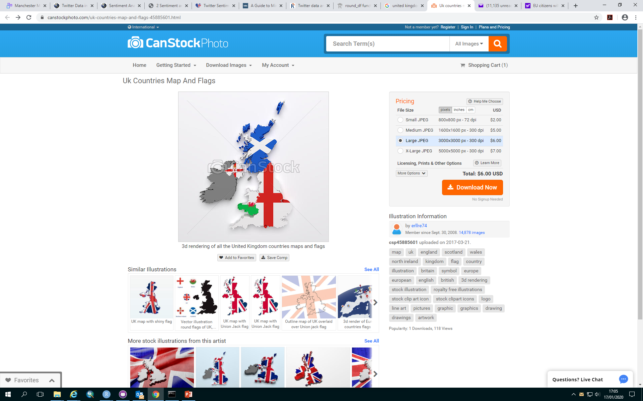

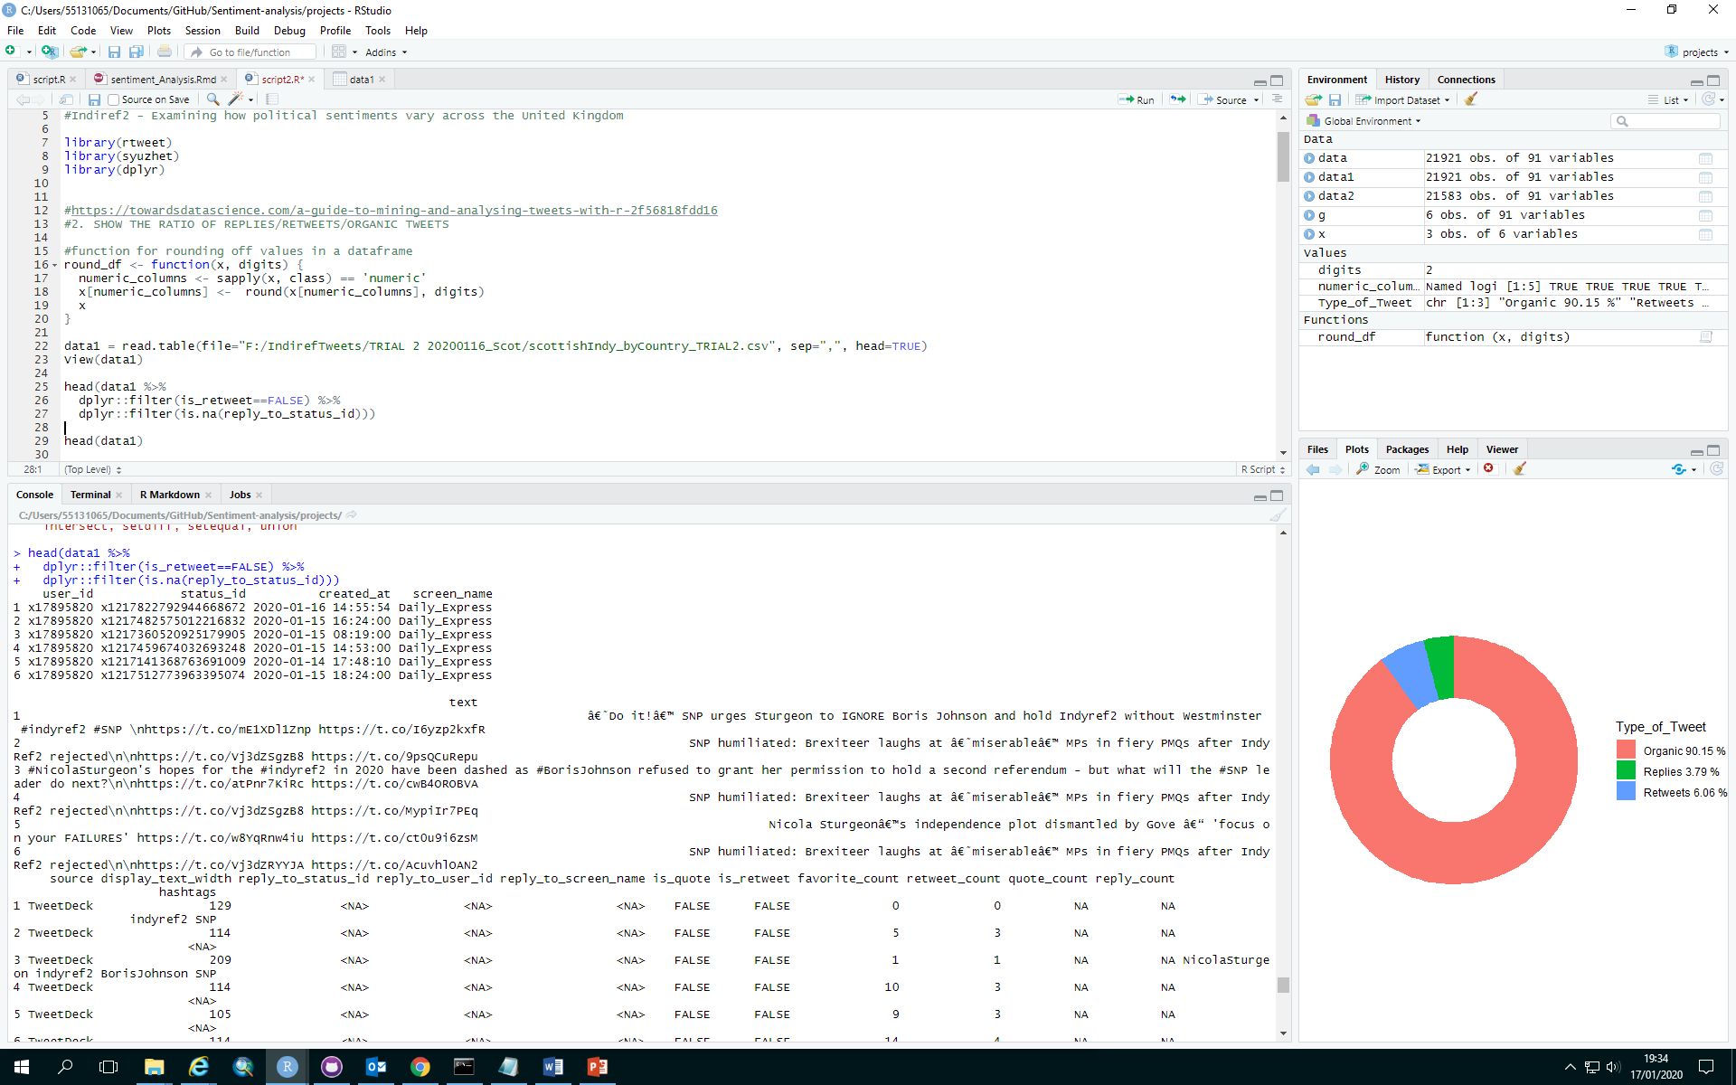

Slide 4
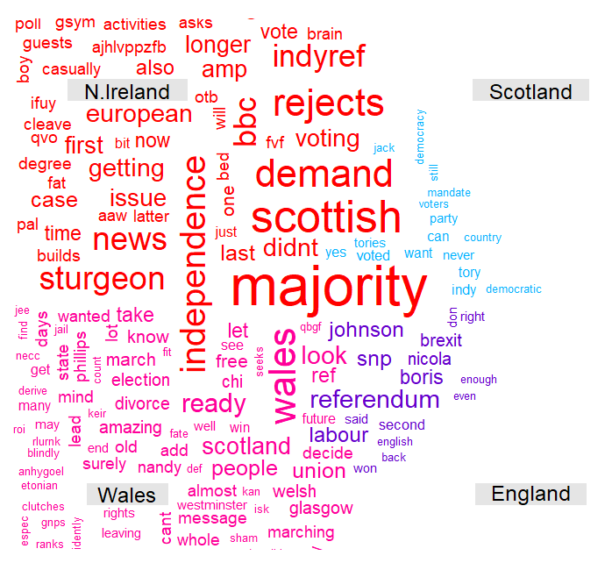
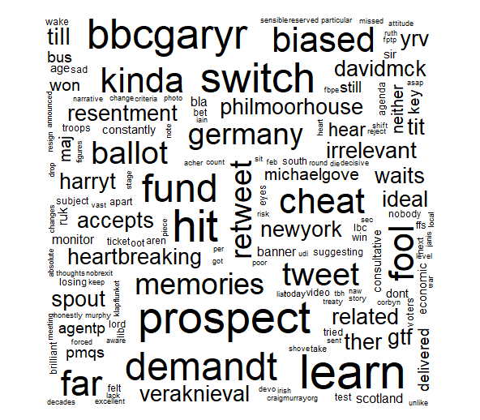

Slide 5
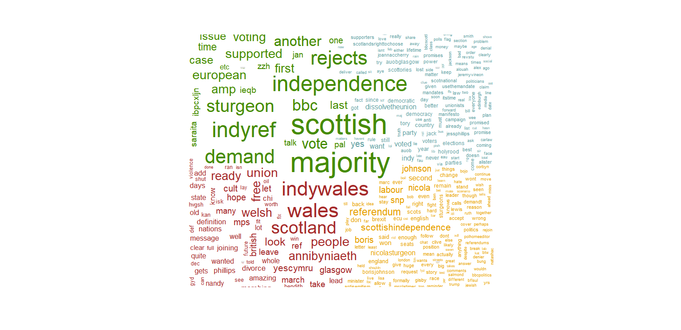
Common Words Frequencies between countries
Differences in Word Frequencies within countries

Slide 6
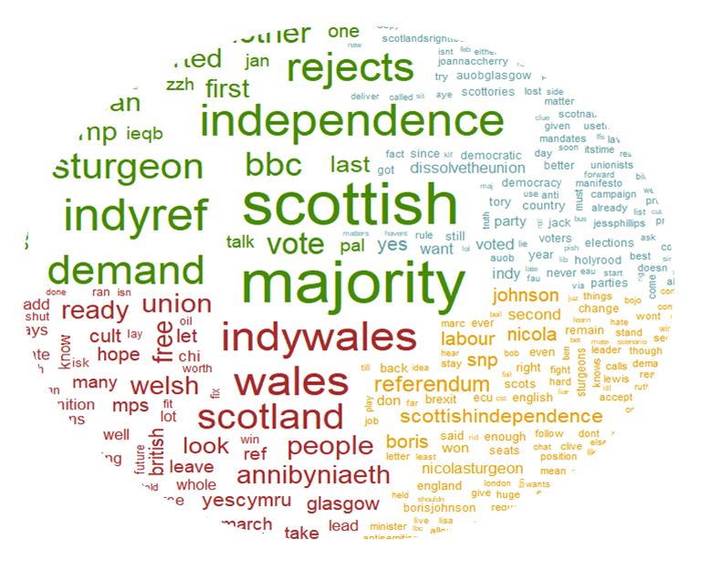
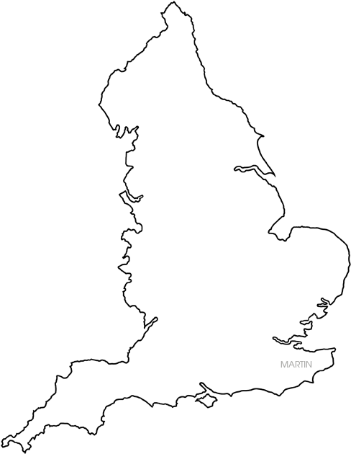
Common Words Frequencies between countries

Slide 7
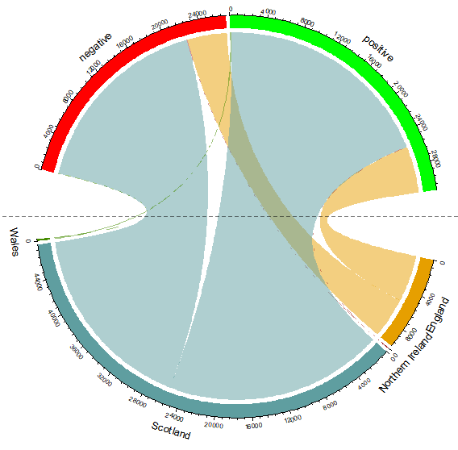
Negative
Polar Sentiment
Positive
Wales
England
Northern Ireland
Scotland

Slide 8
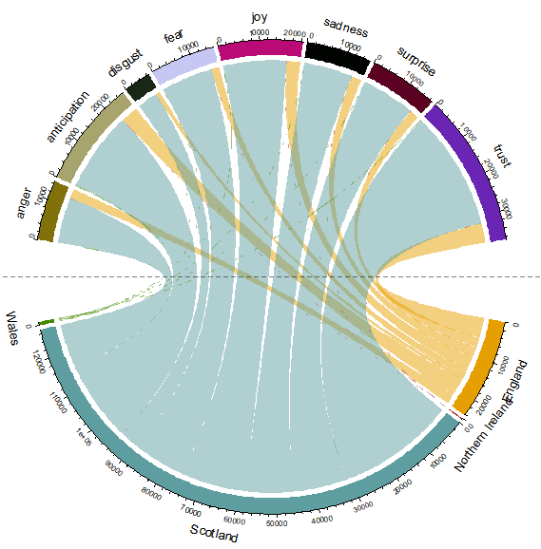
Expanded Sentiment
Joy
Sadness
Fear
Disgust
Surprise
Anticipation
Trust
Anger
Wales
England
Northern Ireland
Scotland

Slide 9
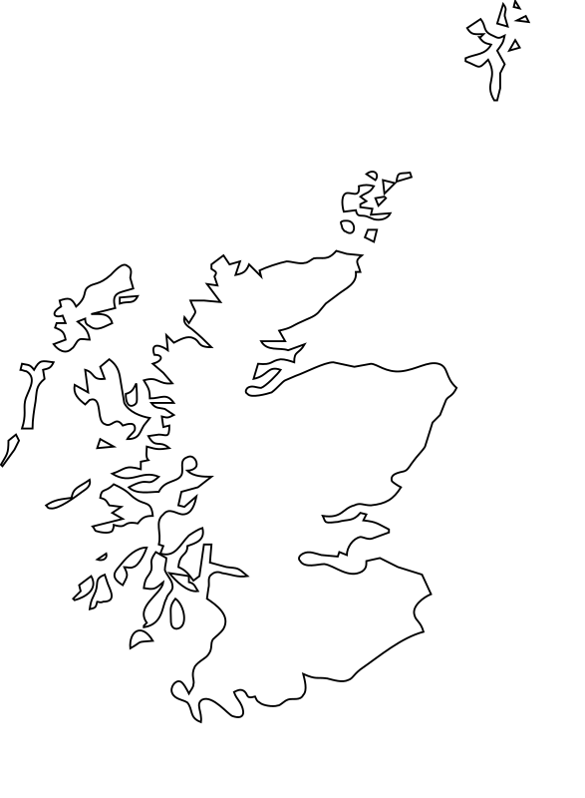
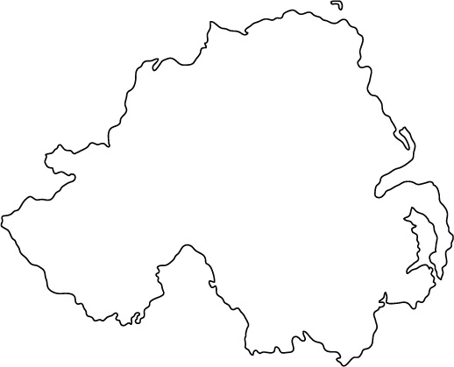
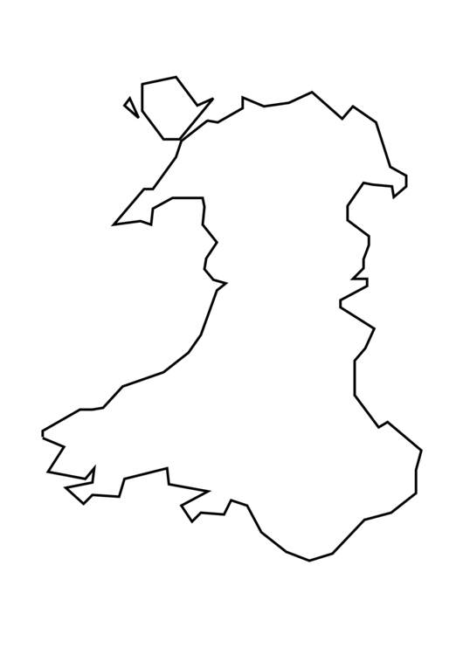
Scotland
Northern Ireland
England
Wales

Slide 10
